Slide 1
Optimization of Quantum Circuit based on Surface Code
Group Member: 邹昊江，张浚垠，刘正韬，庄竞泽
Jingze Zhuang, March 11

Slide 2
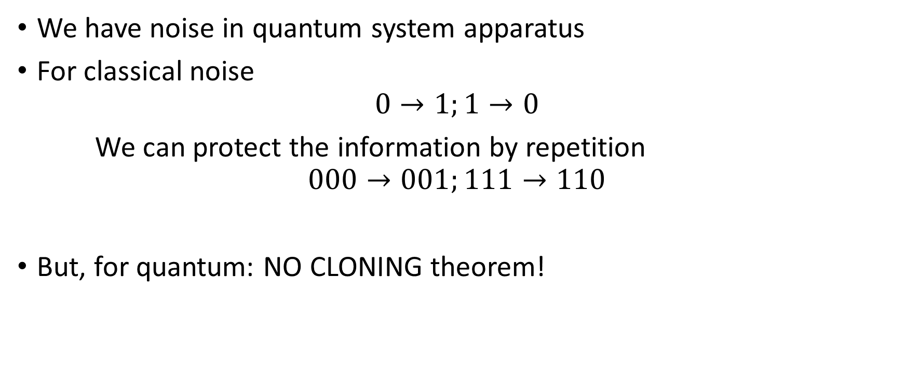
Error Correction: An Introduction
We have noise in quantum system apparatus
For classical noise
$$0→1;1→0$$
We can protect the information by repetition
$$000→001;111→110$$
But, for quantum: NO CLONING theorem!

Slide 3


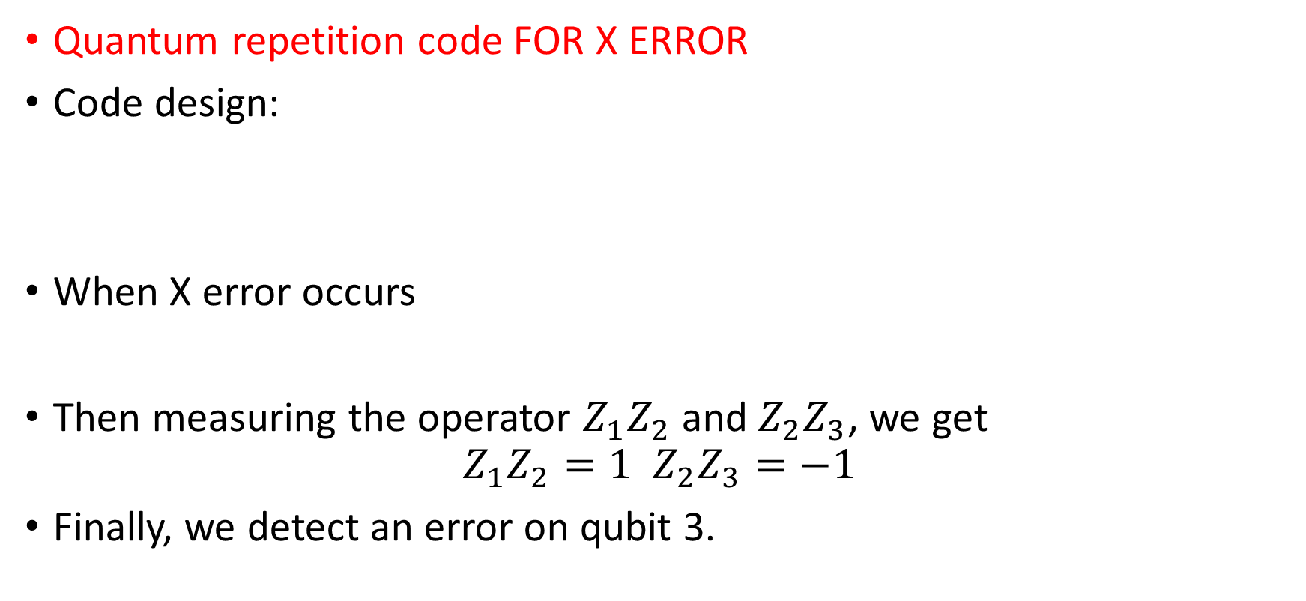
Error Correction: An Introduction
Quantum repetition code FOR X ERROR
Code design:
When X error occurs
Then measuring the operator $Z_{1}Z_{2}$ and $Z_{2}Z_{3}$, we get
$$Z_{1}Z_{2}=1 Z_{2}Z_{3}=−1$$
Finally, we detect an error on qubit 3.

Slide 4
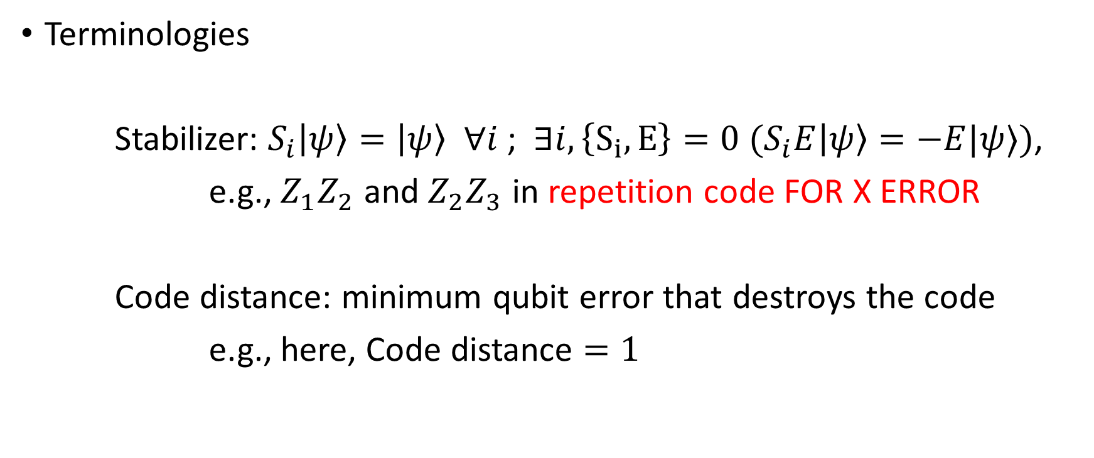
Error Correction: An Introduction
Terminologies
Stabilizer: $S_{i}\left|ψ\right\rangle =\left|ψ\right\rangle ∀i$ ; $∃i, \left\{S_{i},E\right\}=0 (S_{i}E\left|ψ\right\rangle =−E|ψ⟩)$,
e.g., $Z_{1}Z_{2}$ and $Z_{2}Z_{3}$ in repetition code FOR X ERROR
Code distance: minimum qubit error that destroys the code
e.g., here, Code distance $=1$

Slide 5
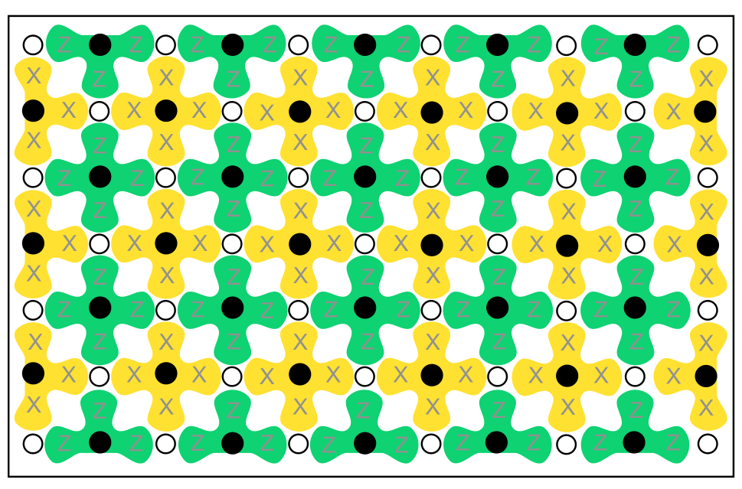
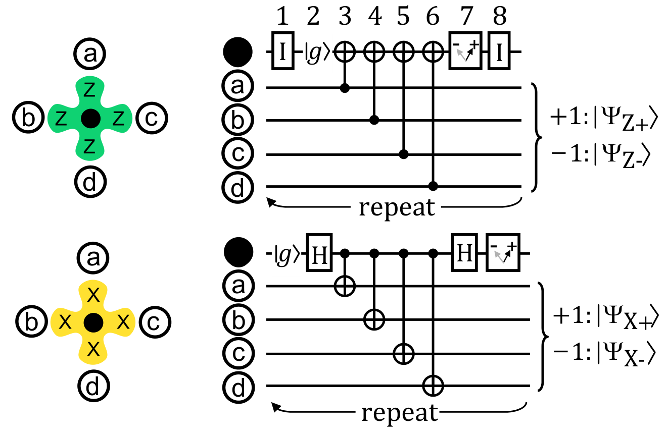
Surface Code – Topologically Protected Info
Z-Stabilizer
X-Stabilizer

Slide 6
Surface Code – Topologically Protected Info
Z-Stabilizer
X-Stabilizer

Slide 7
Surface Code – Topologically Protected Info
Z-Stabilizer
X-Stabilizer

Slide 8
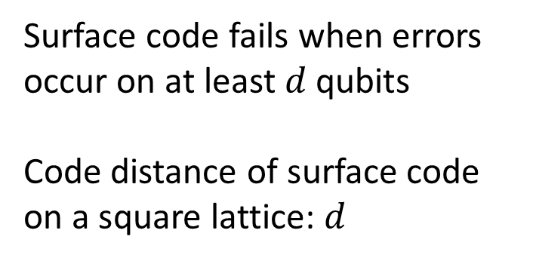
Surface Code – Topologically Protected Info
Surface code fails when errors occur on at least $d$ qubits
Code distance of surface code on a square lattice: $d$

Slide 9
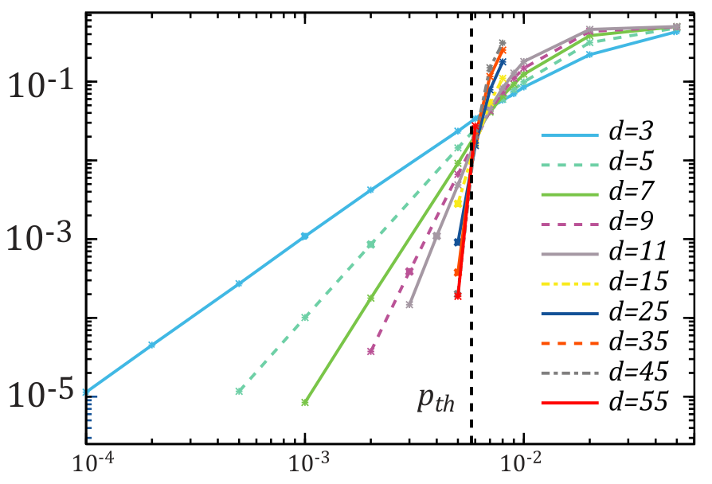
Surface Code – Error rate
Larger system, better error rate?
No!
Error Threshold
Logical error rate
Physical error rate

Slide 10
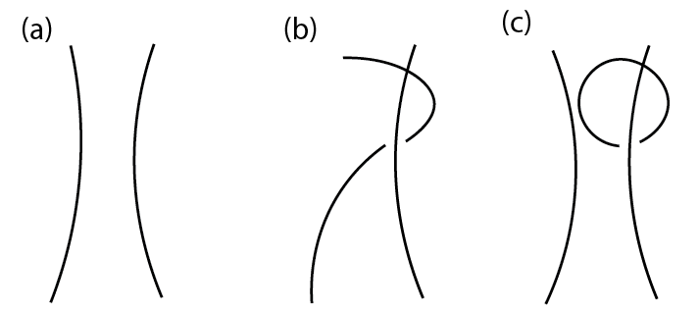
Surface Code for Quantum Computation
Supported gates: Clifford Gate
Single qubit gate: Identity, X, Y, Z, Hadamard, Phase gate (S), T
Multi-qubit gate: CNOT
The most difficult one to realize (and to simulate) is CNOT
involves topological braiding.

Slide 11
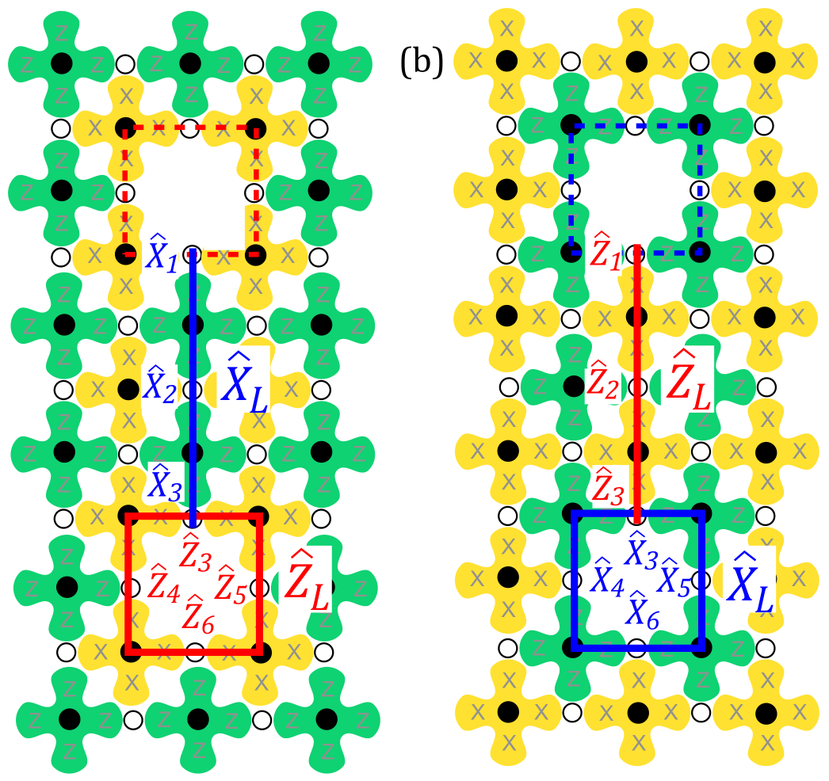
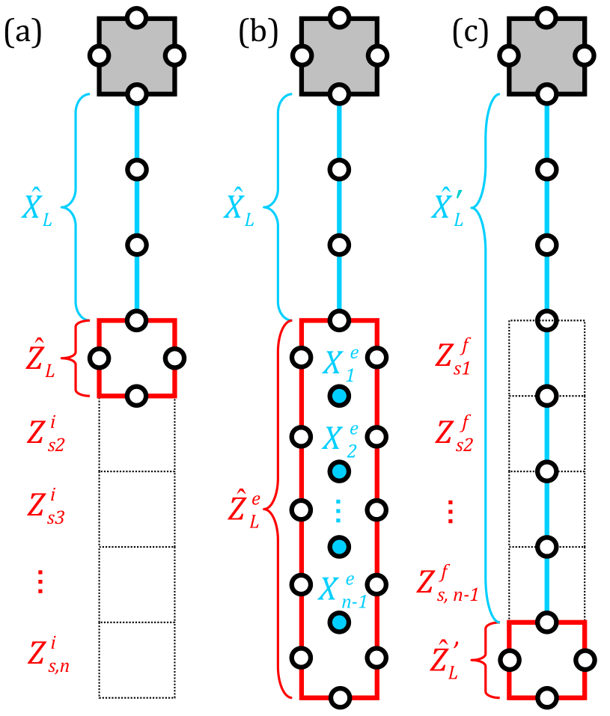
Surface Code for Quantum Computation
Z-type Qubit
X-type Qubit
Qubit movement

Slide 12
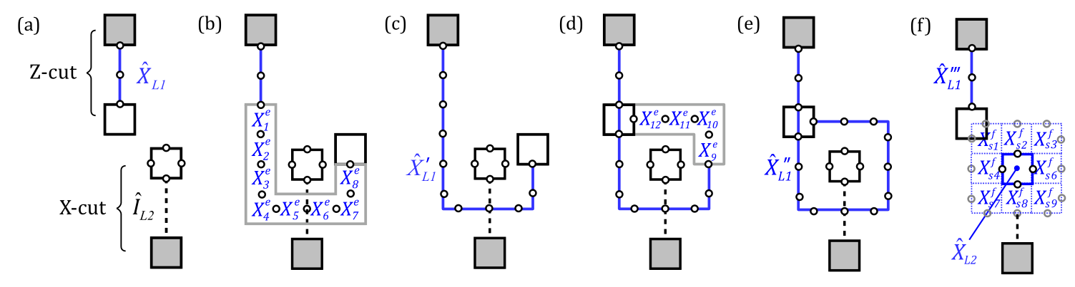
Surface Code for Quantum Computation
Braiding

Slide 13
Our Work
Simulation: Surface Code for storage & for computation
Code geometry: Construction and Maintenance
Physical error generation
Error detecting & correcting simulation
Logical error detection
Error statistics and Error threshold calculation
Quantum Circuit Transform
Automatic Optimization of Quantum Circuit based on Surface Code

Slide 14
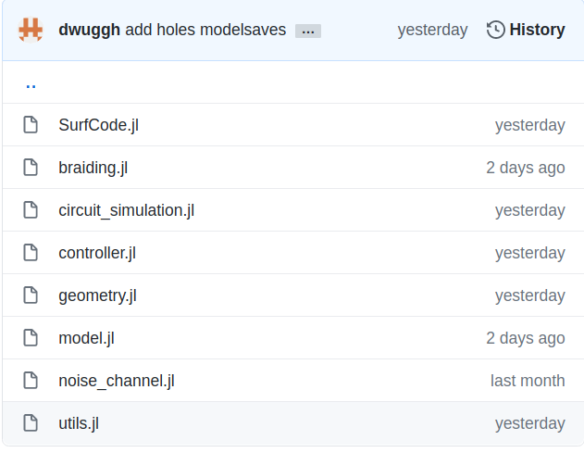
Features
Language: Julia, nearly fast as C!
Functional programming & polymorphism behavior
Strong, complex program with Simple Clear API
Easy for unlimited further extension!
1000+ lines of Julia!

Slide 15
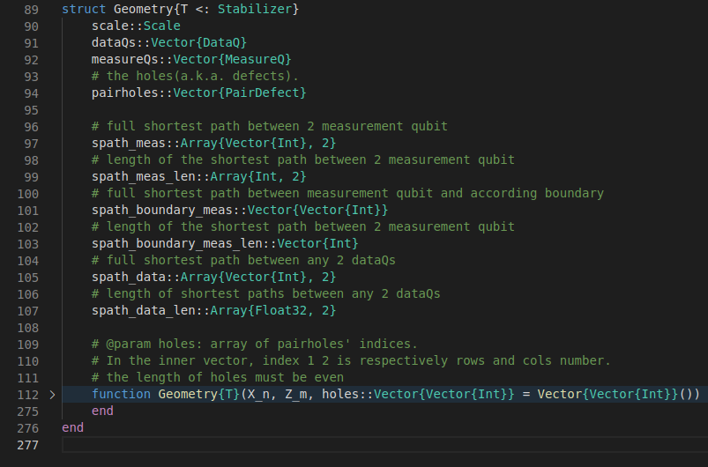
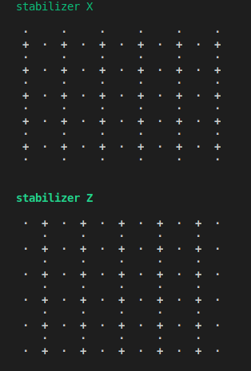
Geometry Generator
Visualize

Slide 16
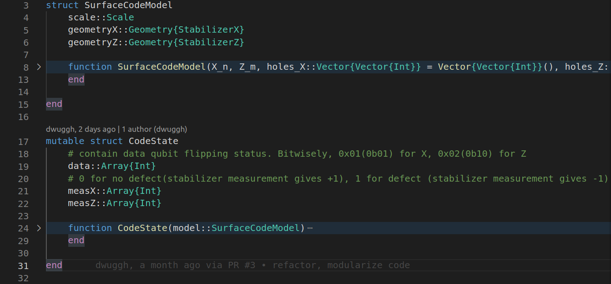
Structure: Code State
From code geometry, specify the code state

Slide 17
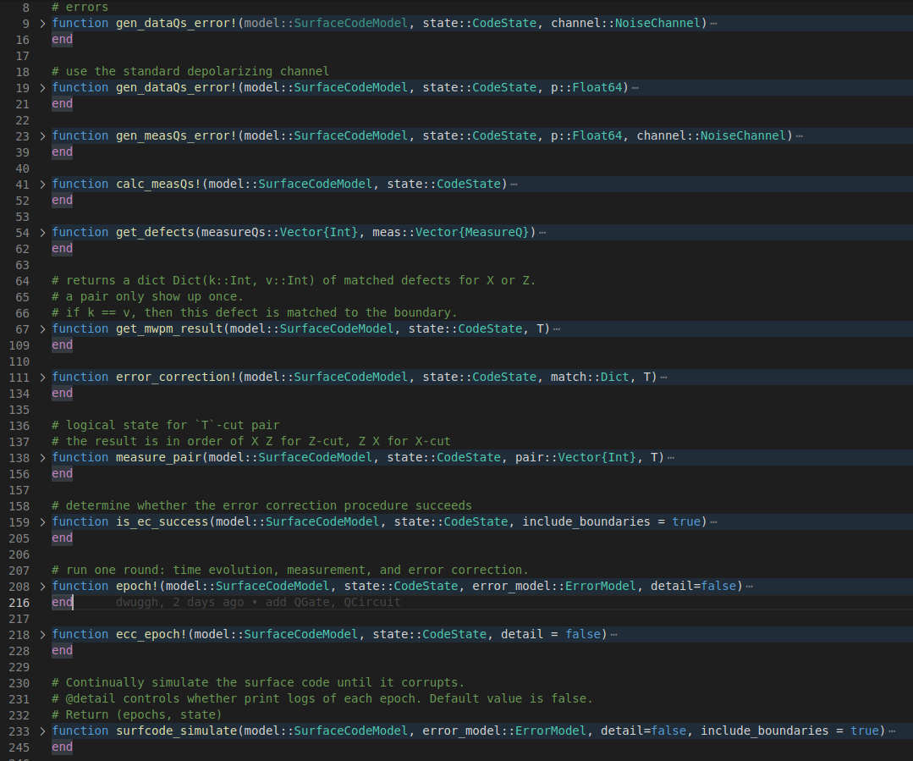
Code Simulation Utils
Generate errors
Error detection simulation
Error correction simulation
Correction succeed / failed ?

Slide 18
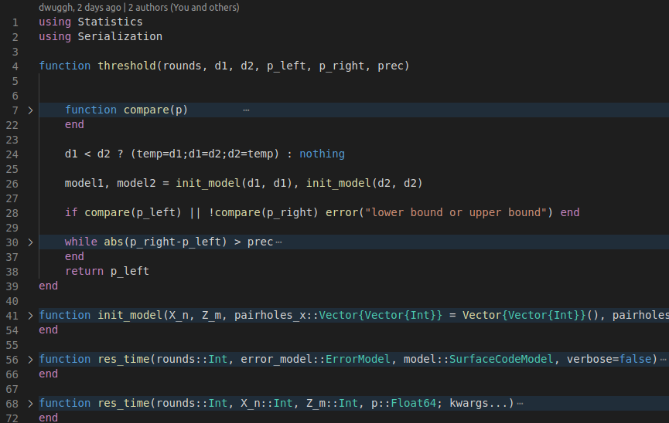
Simulation Controller
With controller, we can calculate error rate to arbitrary given precision
Thus, error threshold can be calculated

Slide 19
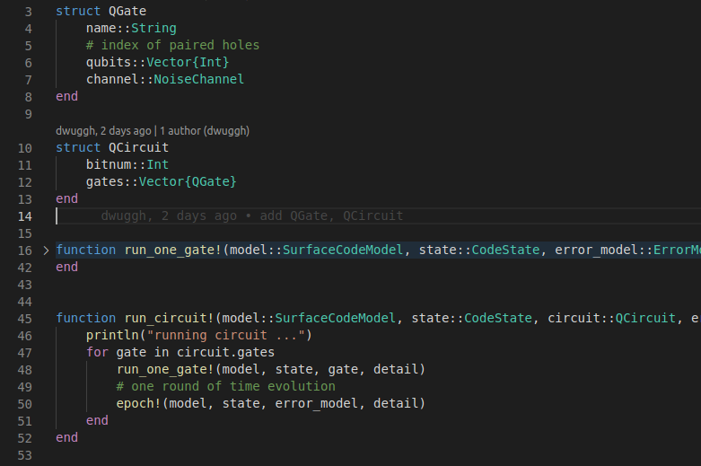
Quantum Circuit Simulation
After the above all, we can now run one gate and assemble them to get a whole circuit!

